Slide 1
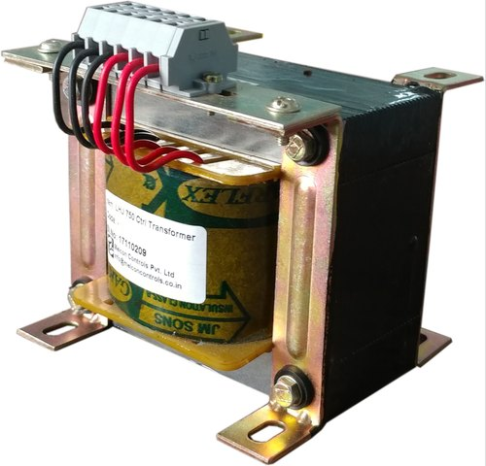
Transformer based Shock Prevent and control system using IoT

Slide 2
Introduction
Transformer is the key equipment in a power system and hence ensuring its safe and stable operation is grave. Here the term "Monitoring" is here defined as an on-line collection of data related to transformer performance. In power systems, distribution transformer is an electrical equipment which distributes power to the low-voltage users directly, and its operation condition is an important component of the entire distribution network operation.
However, their life is significantly reduced if they are subjected to overloading, resulting in unexpected failures and interruption of supply to a large number of customers thus effecting system reliability.

Slide 3
Overloading and ineffective cooling of transformers are the major causes of failure in distribution transformers. The monitoring devices or systems which are presently used for monitoring distribution transformer possess so many drawbacks [1]. Moreover, it is very difficult and expensive to construct the communication wires to monitor and control each distribution transformer station.
The problems faced by the existing system are mentioned below;
(1) Ordinary transformer measurement system generally detects a single transformer parameter, such as power, current, voltage, or phase. While some method could detect multi-parameter, the time of acquisition of operation parameters is too long, and testing speed is not fast enough.
(2) Detection system itself is not reliable. The main drawback is the device instability, poor anti-jamming capability.
(3) Timely detection data updates are not sent to monitoring centers in regular intervals.

Slide 4
The Life of Distribution Transformer Can Be Significantly Increased by Operating It At A Rated Suitable Condition As Per Specification. However If Overloaded Their Life Is Essentially Decreased Because Of Unexpected Failures And Loss Of Supply To A Great Number Of Customers. The Main Reason for Failure In Distribution Transformers Is Over Loading And Non Efficient Cooling.

Slide 5
Literature Survey
The process of rebuilding in the field of electricity industry results in a need of innovative techniques for representing a huge quantity of system data. Overbye and Weber have presented a summary on various visualization techniques that might fairly be helpful for the representation of the data.
The techniques such as: 1.) contouring, 2.) animation, 3.) data aggregation and, 4.) virtual environments must prove to be quite useful. Yet, important challenges remain.
The major challenges are: 1.) the problem of visualizing not just the state of a existing system but also the potentially huge number of incident states, and, 2.) the problem of visualizing not just the impact of a solitary proposed power transfer but of a great number of such transactions.

Slide 6
Johan Driesen et al. have discussed the model of an flexible energy measurement system consisting of a DSP, sensor and communication units. The modern electricity distribution networks utilize this system, featured by multiple suppliers in a deregulated market, bi-directional energy flows owing to the distributed generation and a diversified demand for the quality of electricity delivery. Different features of the system relating to signal processing, communication and dependability were discussed. Their work also includes the examples of the use of such devices.
Daponte et al. have discussed the design and implementation of Transient meter, a monitoring system for the detection, classification and measurement of disturbances on electrical power systems. CORBA architecture is utilized as communication interface by the Transient meter, wavelet-based techniques for automatic signal classification and characterization, and a smart trigger circuit for the detection of disturbances. A measurement algorithm, developed by using the wavelet transform and wavelet networks, had been adopted for the automatic classification and measurement of disturbances.

Slide 7
The results that are obtained after the process of monitoring a distribution transformer during a period of 18 months was described and discussed by Humberto Jimenez et al. The transformer fed several households, each with a grid connected photovoltaic system, and it was identified that the power factor at the transformer attained strange low levels. This was because of the fact that under some circumstances, the systems offer a great portion of the active power that is demanded by the households, whereas the grid supplied all the reactive and distortion powers. The operating temperature was used as an indicator for the pressure on transformer. The temperature level was least when the systems were providing the maximum energy available from the solar cells.
Power quality monitoring systems are capable of detecting disturbances by means of Mathematical Morphology (MM) very quickly. Yet, the signal under examination is frequently corrupted by noises, and the performance of the MM would be greatly degraded. Sen Ouyang and Jianhua Wang [12] have presented a quick process in order to detect the transient disturbances in a noisy atmosphere. In this approach, the suitable morphologic structure element, appropriate mixture of the erosion and the dilation morphologic operators can develop the capability of MM. In addition, the soft-threshold denoising technique based on the Wavelet Transform (WT) was used for purpose of reference. Thus, the abilities of the MM can hence be restored. This technique has possessed the following merits: 1.) Great speed in calculation, 2.) easy implementation of hardware and, 3.) better use value.

Slide 8
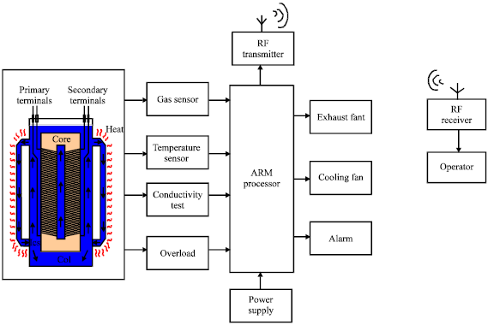
Existing System
Real time monitoring and controlling transformer:
The block diagram shown in Fig. depicts the hardware configuration of the complete system.
General faults in a transformer can be grouped as: (1) Mechanical, (2) Contacts erosion and (3) Contact coking leading to high resistance and overheating.
In order to reduce some internal failures like risk of fire and explosions, several standards and protective devices have been installed. There are several parameters which will affect the working of the transformer. The four main parameters that are mainly concerned here are gas, temperature, overload and oil.

Slide 9
System Design
Transformer 12v1amp:
It is a general-purpose chassis mounting mains transformer. Transformer has 240 V primary windings and center tapped secondary winding. The transformer has flying colored insulated connecting leads (Approx. 100 mm long). The Transformer act as step down transformer reducing AC - 240V to AC - 12V.
The Transformer gives two outputs of 24V, 12V and 0V. The Transformer's construction is written below with details of Solid Core and Winding.
The transformer is a static electrical device that transfers energy by inductive coupling between its winding circuits. A varying current in the primary winding creates a varying magnetic flux in the transformer's core and thus a varying magnetic flux through the secondary winding. This varying magnetic flux induces a varying electromotive force (E.M.F) or voltage in the secondary winding. The transformer has cores made of high permeability silicon steel. The steel has a permeability many times that of free space and the core thus serves to greatly reduce the magnetizing current and confine the flux to a path which closely couples the windings.

Slide 10
What is Arduino?
Arduino is an open-source electronics platform based on easy-to-use hardware and software.
Arduino boards are able to read inputs - light on a sensor, a finger on a button, or a Twitter message - and turn it into an output - activating a motor, turning on an LED, publishing something online.
You can tell your board what to do by sending a set of instructions to the microcontroller on the board.

Slide 11
Its simple and accessible user experience, Arduino has been used in thousands of different projects and applications.
The Arduino software is easy-to-use for beginners, yet flexible enough for advanced users.
It runs on Mac, Windows, and Linux. Teachers and students use it to build low cost scientific instruments, to prove chemistry and physics principles, or to get started with programming and robotics.
Designers and architects build interactive prototypes, musicians and artists use it for installations and to experiment with new musical instruments. Makers, of course, use it to build many of the projects exhibited at the Maker Faire, for example.
Arduino is a key tool to learn new things. Anyone - children, hobbyists, artists, programmers - can start tinkering just following the step by step instructions of a kit, or sharing ideas online with other members of the Arduino community.

Slide 12
Features:
Inexpensive - Arduino boards are relatively inexpensive compared to other microcontroller platforms. The least expensive version of the Arduino module can be assembled by hand, and even the pre-assembled Arduino modules cost less than $50
Cross-platform - The Arduino Software (IDE) runs on Windows, Macintosh OSX, and Linux operating systems. Most microcontroller systems are limited to Windows.
Simple, clear programming environment - The Arduino Software (IDE) is easy-to-use for beginners, yet flexible enough for advanced users to take advantage of as well. For teachers, it's conveniently based on the Processing programming environment, so students learning to program in that environment will be familiar with how the Arduino IDE works.
Open source and extensible software - The Arduino software is published as open source tools, available for extension by experienced programmers. The language can be expanded through C++ libraries, and people wanting to understand the technical details can make the leap from Arduino to the AVR C programming language on which it's based. Similarly, you can add AVR-C code directly into your Arduino programs if you want to.
Open source and extensible hardware - The plans of the Arduino boards are published under a Creative Commons license, so experienced circuit designers can make their own version of the module, extending it and improving it. Even relatively inexperienced users can build the breadboard version of the module in order to understand how it works and save money.

Slide 13
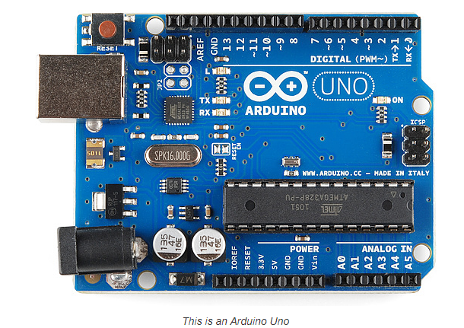

Slide 14
3. LM35:
LM35 is a temperature sensor which can measure temperature in the range of -55°C to 150°C.
It is a 3-terminal device that provides analog voltage proportional to the temperature. Higher the temperature, higher is the output voltage.
The output analog voltage can be converted to digital form using ADC so that a microcontroller can process it.

Slide 15
4. Voltage Sensor:
A voltage sensor is a sensor is used to calculate and monitor the amount of voltage in an object. Voltage sensors can determine both the AC voltage or DC voltage level. The input of this sensor can be the voltage whereas the output is the switches, analog voltage signal, a current signal, an audible signal, etc.
Sensors are basically a device which can sense or identify and react to certain types of electrical or some optical signals. Implementation of voltage sensor and current sensor techniques have become an excellent choice to the conventional current and voltage measurement methods.
The Voltage Sensor is a simple module that can used with Arduino (or any other microcontroller with input tolerance of 5V) to measure external voltages that are greater than its maximum acceptable value i.e. 5V in case of Arduino.
Before going into the details of the Voltage Sensor like its functionality and schematic, let me give you an overview of the available Pins of the Voltage Sensor Module.
Basically, a 25V Voltage Sensor, like the one used here, has 5 pins in total. Two of them are on the two-pin screw terminal and three are male header pins.
The Screw Terminal pins are marked as VCC and GND and they must be connected to the external source of voltage i.e. the voltage that needs to be measured.
Coming to the three male headers, they are marked as S, + and –. The S pin is the “Sense” pin and it must be connected to the Analog Input of the Arduino. The “–” pin must be connected to the GND of the Arduino. The pin marked as “+” is not connected to anything (it is an N/C Pin).

Slide 16
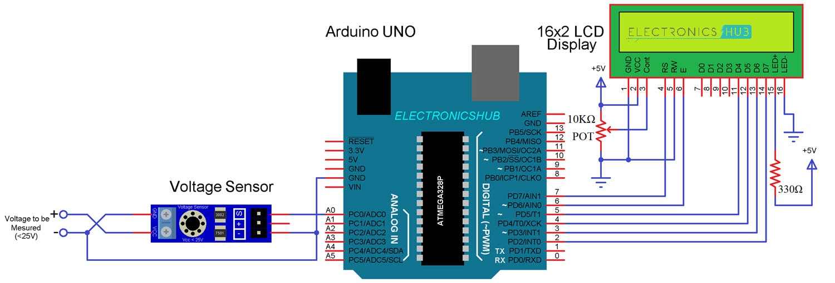

Slide 17
5. 5V Relay:
The relay has two different types of electrical contacts inside – normally open (NO) and normally closed (NC). The one you use will depend on whether you want the 5V signal to turn the switch on or turn the switch off. The 120-240V supply current enters the relay at the common (C) terminal in both configurations. To use the normally open contacts, use the NO terminal. To use the normally closed contacts, use the NC terminal.
NORMALLY OPEN
In the normally open configuration, when the relay receives a HIGH signal the 120-240V switch closes and allows current to flow from the C terminal to the NO terminal. A LOW signal deactivates the relay and stops the current. So if you want the HIGH signal to turn ON the relay, use the normally open terminal:
NORMALLY CLOSED
In the normally closed configuration, a HIGH signal opens the switch and interrupts the 120-240V current. A LOW signal closes the switch and allows current to flow from the C terminal to the NC terminal. Therefore, if you want the HIGH signal to turn OFF the 120-240V current, use the normally closed terminal

Slide 18
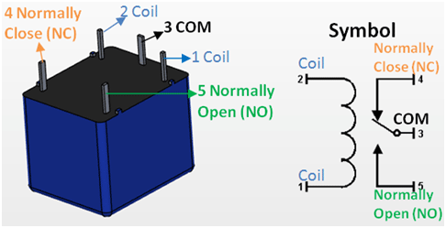

Slide 19
ESP8266 WiFi Module Interfacing with Arduino UNO
ESP8266 wifi module is low cost standalone wireless transceiver that can be used for end-point IoT developments.
ESP8266 wifi module enables internet connectivity to embedded applications. It uses TCP/UDP communication protocol to connect with server/client.
To communicate with the ESP8266 wifi module, microcontroller needs to use set of AT commands. Microcontroller communicates with ESP8266-01 wifi module using UART having specified Baud rate (Default 115200).

Slide 20
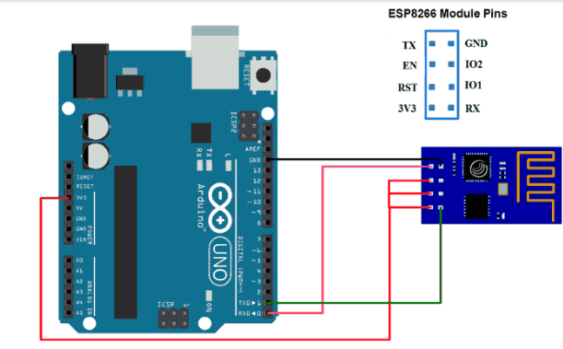

Slide 21
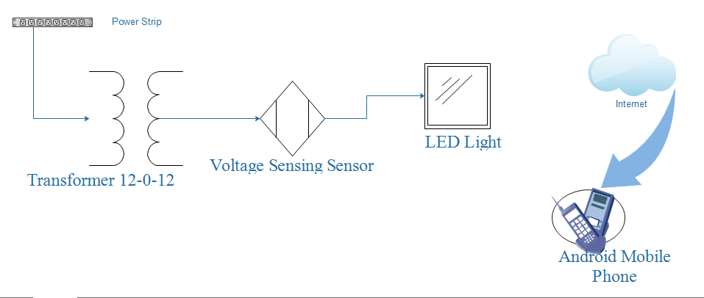
Proposed System

Slide 22
Over Load
Over Load Over current is the current flowing through the transformer resulting from faults on the power system. Fault currents that do not include ground are generally in excess of four times full-load current; fault currents that include ground can be below the full-load current depending on the system grounding method. Over current conditions are typically short in duration (less than two seconds) because protection relays usually operate to isolate the faults from the power system. Overload, by contrast, is current drawn by load, a load current in excess of the transformer nameplate rating. In summary, loading large power transformers beyond nameplate ratings can result in reduced dielectric integrity, thermal runaway condition (extreme case) of the contacts of the tap changer, and reduced mechanical strength in insulation of conductors and the transformer structure. Three factors, namely water, oxygen, and heat, determine the insulation life of a transformer. Filters and other oil preservation systems control the water and oxygen content in the insulation, but heat is essentially a function of the ambient temperature and the load current. Current increases the hottest-spot temperature (and the oil temperature), and thereby decreases the insulation life span.

Slide 23
Temperature
Excessive load current alone may not result in damage to the transformer if the absolute temperature of the windings and transformer oil remains within specified limits. Transformer ratings are based on a 24-hour average ambient temperature of 30°C (86°F). Due to over voltage and over current, temperature of oil increases which causes failure of insulation of transformer winding.

Slide 24
Over/Under Voltage
The flux in the transformer core is directly proportional to the applied voltage and inversely proportional to the frequency. Over voltage can occur when the per-unit ratio of voltage to frequency (Volts/Hz) exceeds 1.05 p .u at full load and 1.10 p .u. at no load. An increase in transformer terminal voltage or a decrease in frequency will result in an increase in the flux. Over excitation results in excess flux, which causes transformer heating and increases exciting current, noise, and vibration .

Slide 25
Implementation

Slide 26
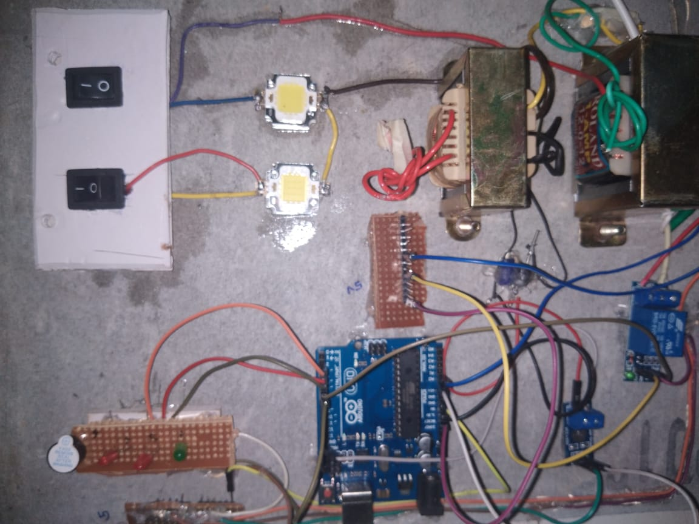

Slide 27
Conclusion
The proposed technique with results has shown that this protection scheme works properly with accuracy. Sensitivity and reliability of this scheme is very high for the abnormal and faulty conditions, as this protection scheme operates within the fractions of seconds when fault or abnormal condition occur. This protection scheme is fully automated and requires no manual interface. In future, this work can also be done using PLCs, and similar technique can also be applied for construction of numerical relays.

